Slide 1
DEPARTMENT OF CIVIL ENGINEERING
GITAM INSTITUTE OF TECHNOLOGY
GITAM UNIVERSITY,VISHAKAPATNAM-45
PREPARED BY :
ESWAR SINGIREDDI

Slide 2
OVERVIEW OF GROUND IMPROVEMENT TECHNIQUES

Slide 3

Shallow Foundations
~ for transferring building loads to underlying ground
~ mostly for firm soils or light loads
firm ground
bed rock

Slide 4

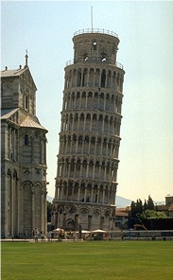
Leaning Tower of Pisa
Our blunders become monuments!

Slide 5
Problems
Less Bearing Capacity
More Settlement
Swelling , Shrinking
Liquefaction
What can be done?
Avoid the site
Distribute Load- Raft Foundation
Bye-pass poor soil- piles
Improve the soil (Ground Improvement/ Modification
Modify Engg. Properties of soil
Increase shear strength of soil
Reduce compressibility of fine element
Increase/Decrease “k”
Modify Swelling/Shrinking behaviour

Slide 6
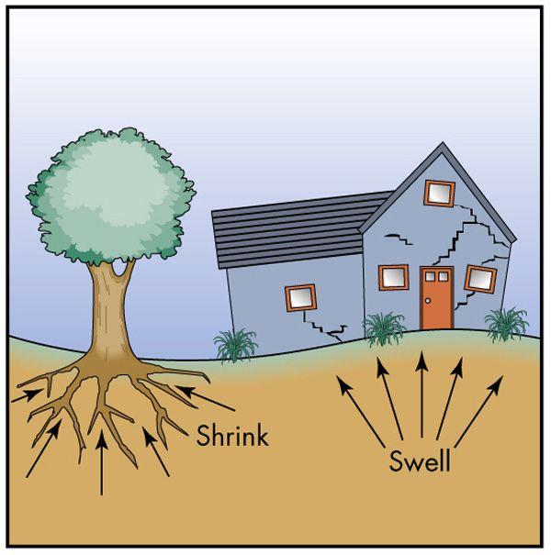
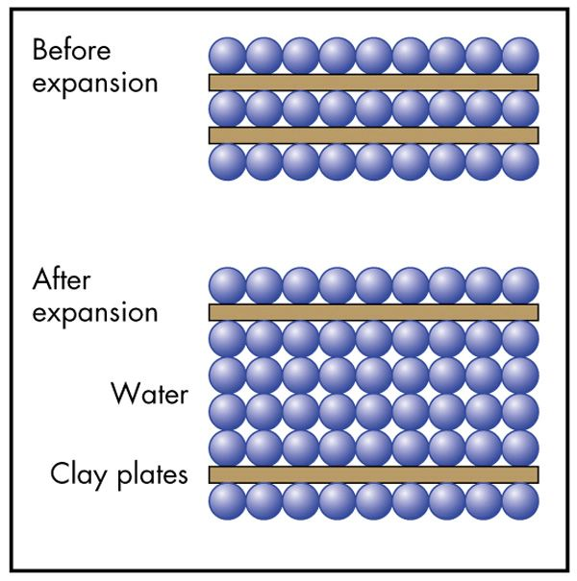
Soil: Shrink-Swell
Clay expands with water input causing differential soil movement and structural damage

Slide 7
Methods of Soil Improvement
Excavation/ Replacement
Compaction
Consolidation
Inclusion of reinforcement

Slide 8
In-situ Ground Improvement
Reducing void spaces by making boreholes and subjecting soil to lateral pressure,
Reducing void space by impact, vibrations or shock,
Reducing saturated void space by rapid drainage of water from it,
filling void spaces with grouts,
Removing existing soil by making bore holes and replacing them with stronger material,
Deep mixing of cementations materials with soil using special tools,
Inserting reinforcing elements into the soil and

Slide 9
Methods for Soil Improvement
Ground
Reinforcement
Ground
Improvement
Ground
Treatment
Stone Columns
Soil Nails
Deep Soil Mixing
Micropiles (Mini-piles)
Jet Grouting
Ground Anchors
Geosynthetics
Fiber Reinforcement
Lime Columns
Mechanically Stabilized Earth
Deep Dynamic Compaction
Drainage/Surcharge
Compaction grouting
Blasting
Surface Compaction
Soil Cement
Lime Admixtures
Flyash
Dewatering
Heating/Freezing
Shaefer, 1997

Slide 10
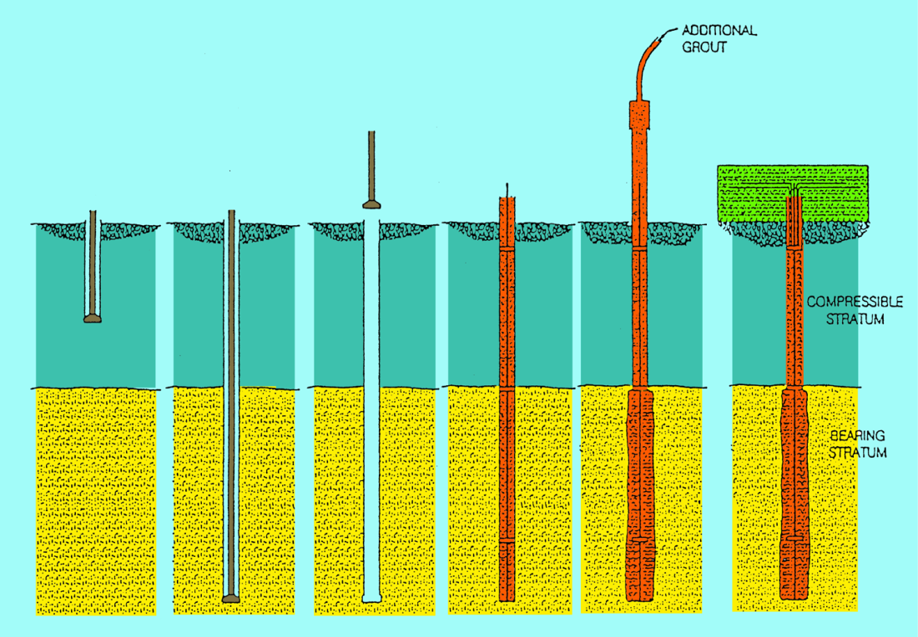
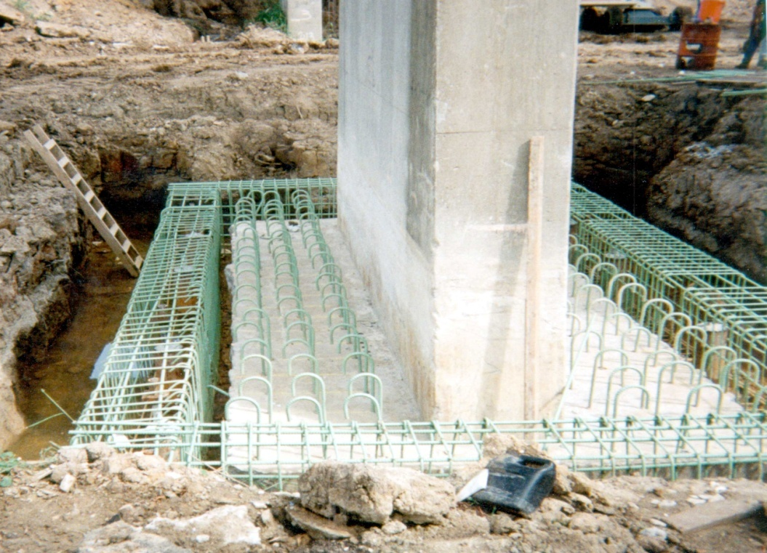
FOUNDATION IMPROVEMENT WITH MICROPILES
To Increase Foundation Capacity or Stiffness
To Resist Overturning Where Existing Cap to Pile Connections Are Inadequate
To Extend Piles Below Liquefiable Layer While Maintaining Vertical Load Capacity During EQ.

Slide 11
Compaction and Objectives
Compaction
Many types of earth construction, such as dams, retaining walls, highways, and airport, require man-placed soil, or fill. To compact a soil, that is, to place it in a dense state.
The dense state is achieved through the reduction of the air voids in the soil, with little or no reduction in the water content. This process must not be confused with consolidation, in which water is squeezed out under the action of a continuous static load.
Objectives:
Decrease future settlements
Increase shear strength
Decrease permeability
(From Lambe, 1991; Head, 1992)

Slide 12
What is compaction?
A simple ground improvement technique, where the soil is densified through external compactive effort.
Compactive effort
+ water =

Slide 13
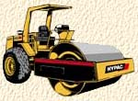
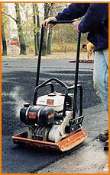
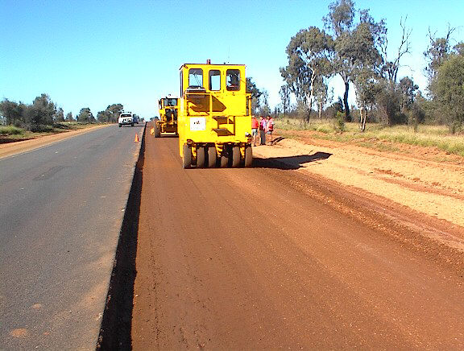
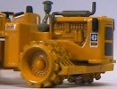
Field Compaction
Different types of rollers (clockwise from right):
Smooth-wheel roller
Vibratory roller
Pneumatic rubber tired roller
Sheepsfoot roller

Slide 14
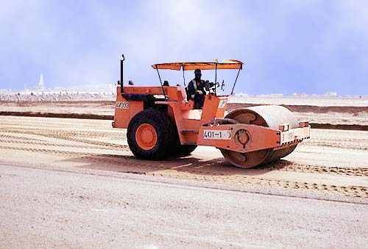
Field Compaction
Smooth Wheeled Roller
Compacts effectively only to 200-300 mm; therefore, place the soil in shallow layers (lifts)

Slide 15
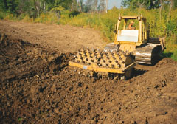
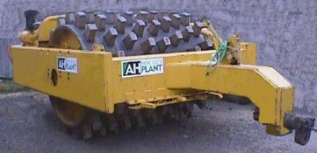
Field Compaction
Sheepsfoot Roller
Provides kneading action; “walks out” after compaction
Very effective on clays

Slide 16
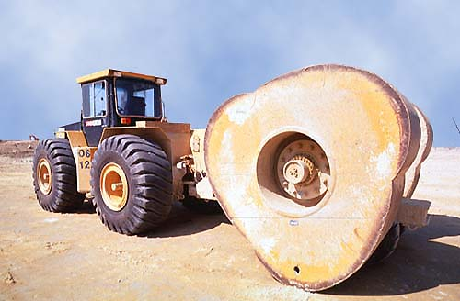
Field Compaction
Impact Roller
Provides deeper (2-3m) compaction. e.g., air field

Slide 17
Earthmoving Equipment

Slide 18
Ground Improvement
Sheepsfoot Roller to Compact Clay Soils

Slide 19
Water Truck

Slide 20
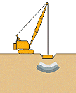
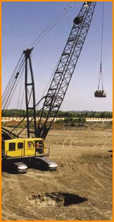
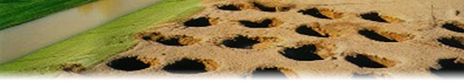
Dynamic Compaction
- pounding the ground by a heavy weight
Suitable for granular soils, land fills
solution cavities in limestone
Pounder (Tamper)
Crater created by the impact
(to be backfilled)

Slide 21
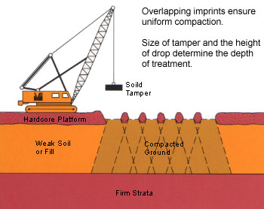
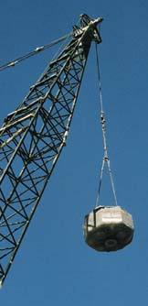
Dynamic Compaction
Pounder (Tamper) Mass = 5-30 tonne Drop = 10-30 m

Slide 22
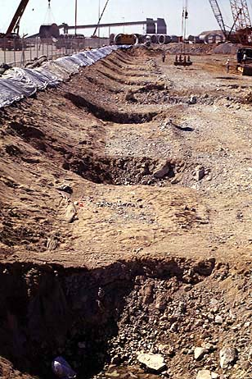
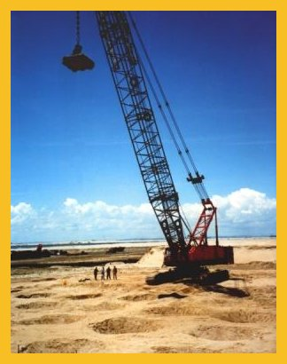
Dynamic Compaction

Slide 23
Dynamic compaction

Slide 24
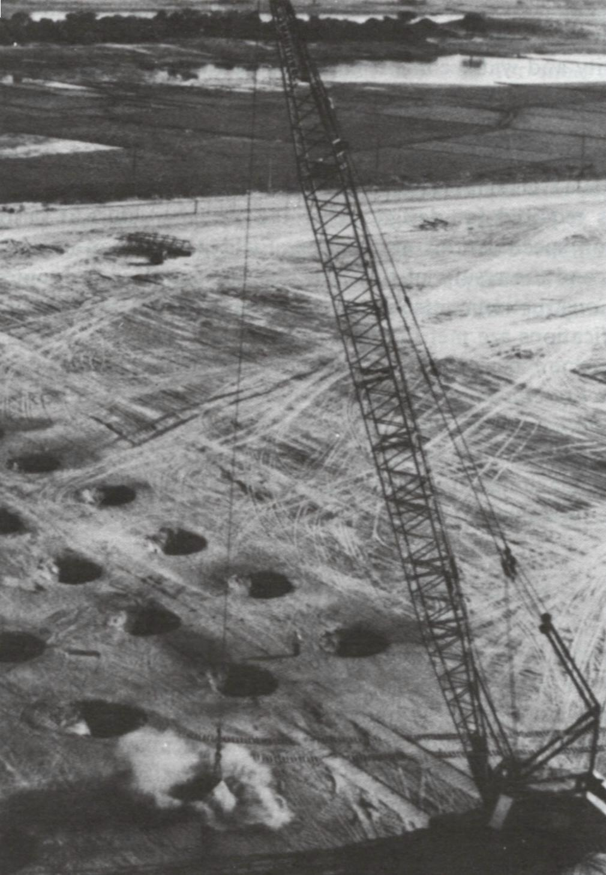
Dynamic Compaction
Dynamic compaction was first used in Germany in the mid-1930’s.
The depth of influence D, in meters, of soil undergoing compaction is conservatively given by
D ≈ ½ (Wh)^{1/2}
W = mass of falling weight in metric tons.
h = drop height in meters

Slide 25
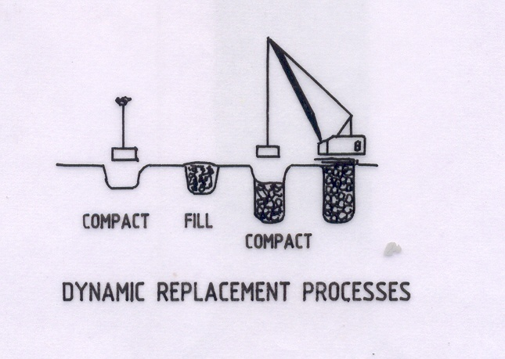
Dynamic Replacement Process

Slide 26
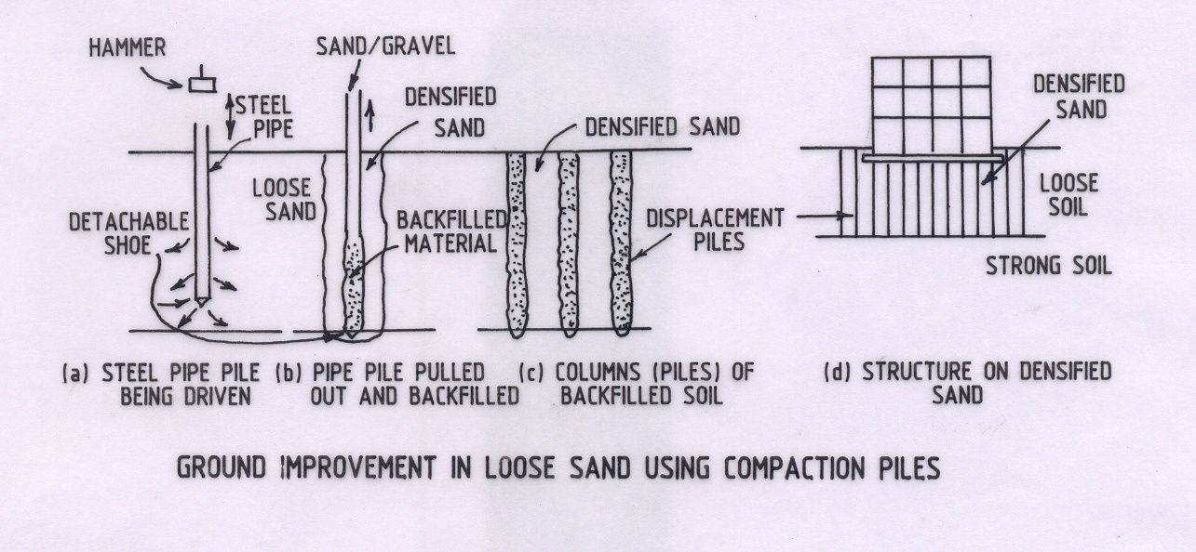
Compaction Piles

Slide 27
Vibro Compaction

Slide 28
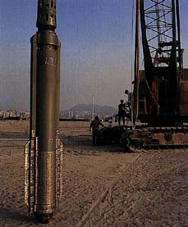
Vibroflotation
Suitable for granular soils
Practiced in several forms:
vibro–compaction
stone columns
vibro-replacement
Vibroflot (vibrating unit) Length = 2 – 3 m Diameter = 0.3 – 0.5 m Mass = 2 tonnes
(lowered into the ground and vibrated)

Slide 29
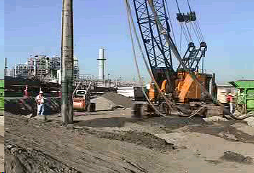
Vibroflotation

Slide 30
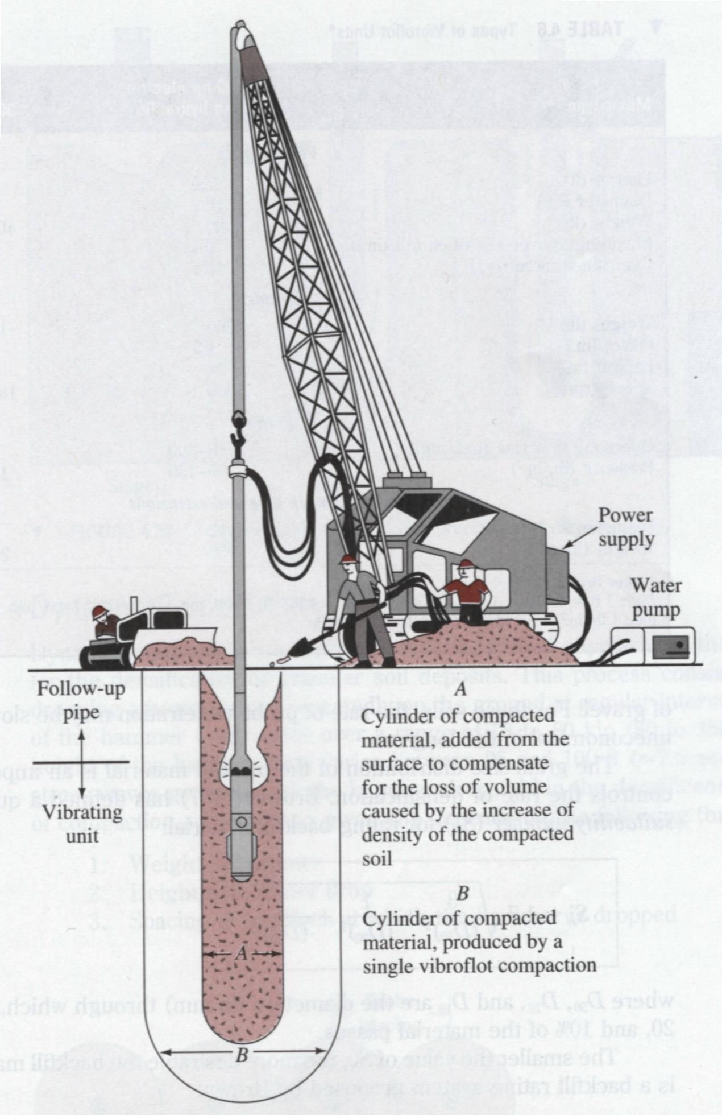
Vibroflotation
Vibroflotation is a technique for in situ densification of thick layers of loose granular soil deposits. It was developed in Germany in the 1930s.
From Das, 1998

Slide 31
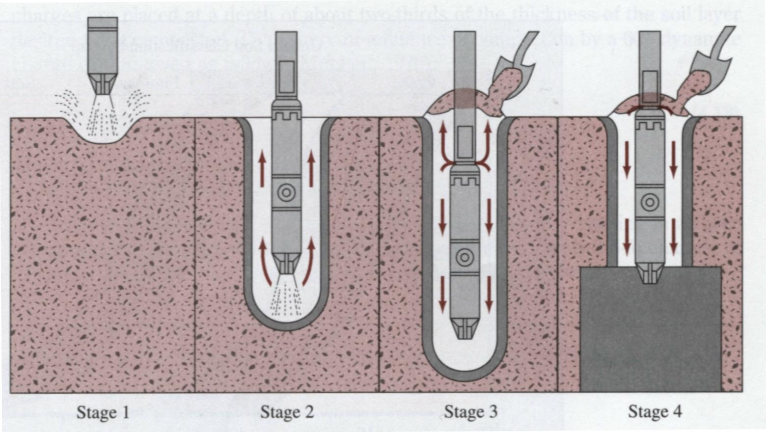
Vibroflotation-Procedures
Stage1: The jet at the bottom of the Vibroflot is turned on and lowered into the ground
Stage2: The water jet creates a quick condition in the soil. It allows the vibrating unit to sink into the ground
Stage 3: Granular material is poured from the top of the hole. The water from the lower jet is transferred to he jet at the top of the vibrating unit. This water carries the granular material down the hole
Stage 4: The vibrating unit is gradually raised in about 0.3-m lifts and held vibrating for about 30 seconds at each lift. This process compacts the soil to the desired unit weight.

Slide 32
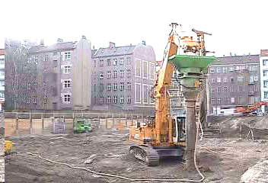
Vibroflotation

Slide 33
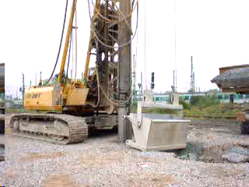
Vibroflotation

Slide 34
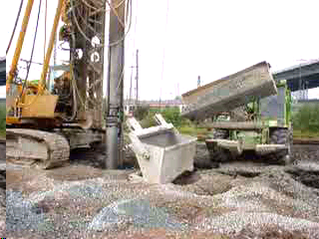
Vibroflotation

Slide 35
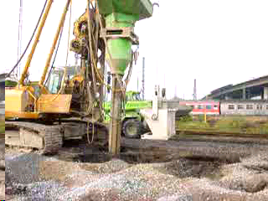
Vibroflotation

Slide 36
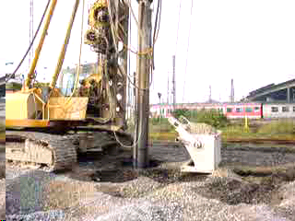
Vibroflotation

Slide 37
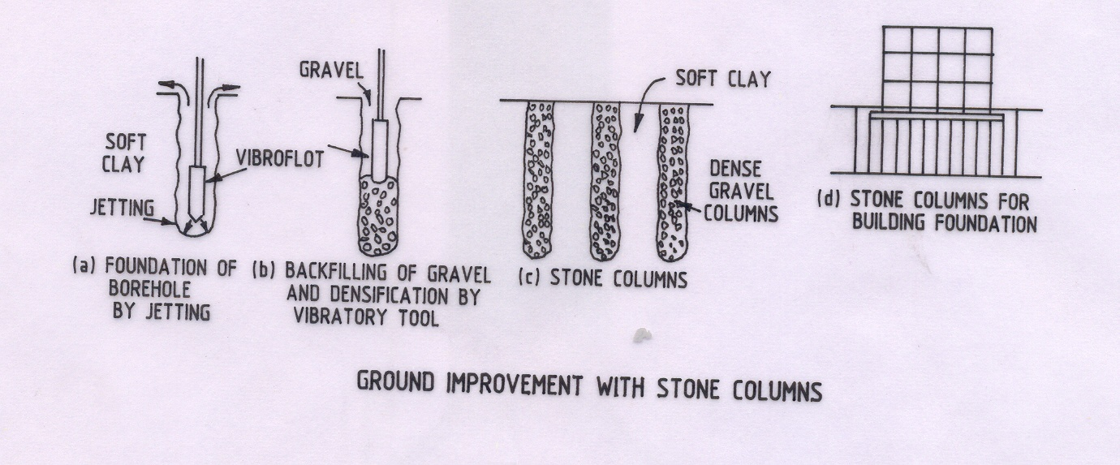
Stone Columns

Slide 38

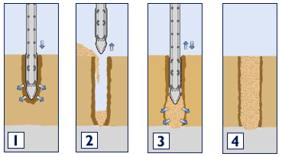
Stone Columns
vibrator makes a hole in the weak ground
..and compacted
Densely compacted stone column
hole backfilled

Slide 39
Sand Drains
Wick Drains
Band Drains

Slide 40
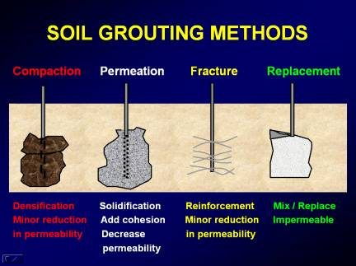

Slide 41
JET GROUTING

Slide 42
GROUTING

Slide 43
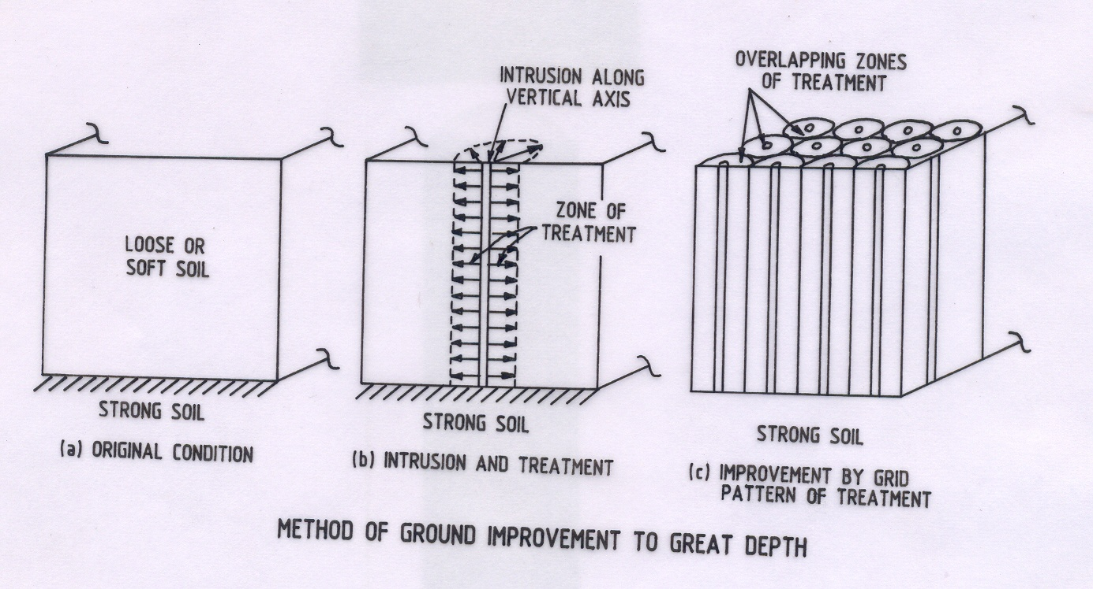
Method of Ground Improvement to Great Depth

Slide 44
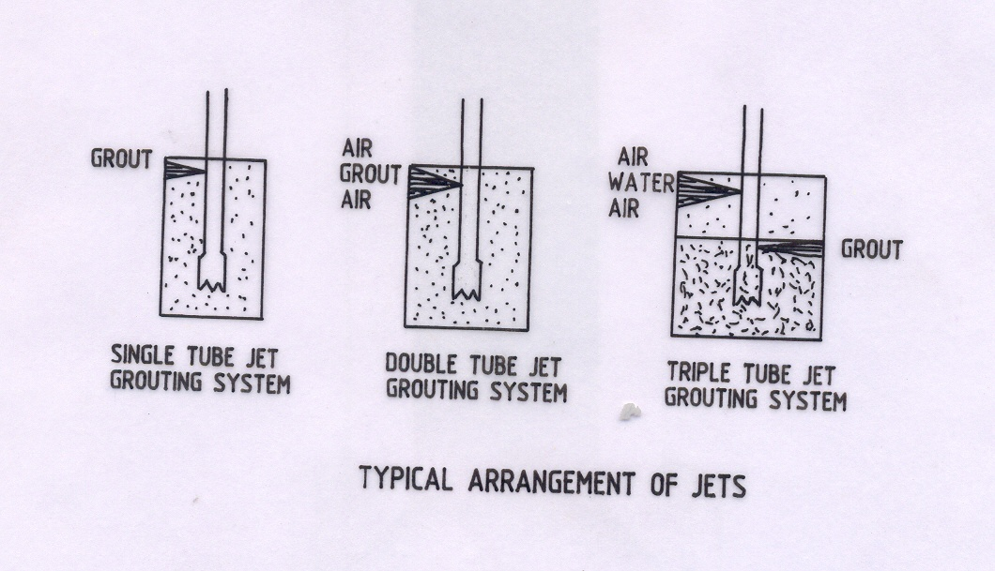
Typical Arrangement of Jets

Slide 45
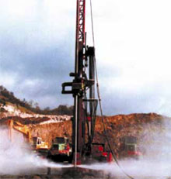
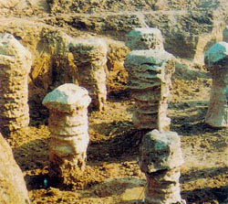
Methods for Soil Improvement- Jet Grouting

Slide 46
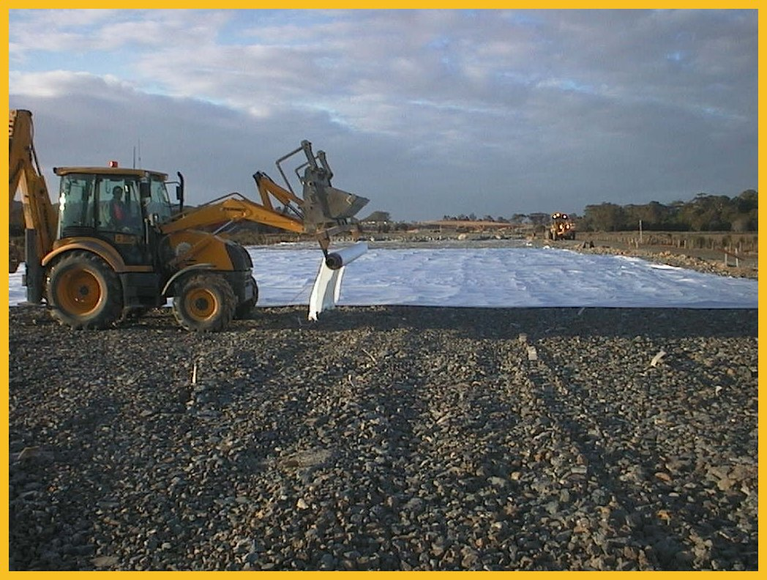
Geofabrics
~ used for reinforcement, separation, filtration and drainage in roads, retaining walls, embankments…
Geofabrics used on Pacific Highway

Slide 47
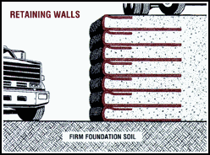
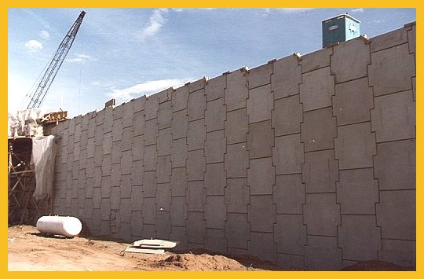
Reinforced Earth Walls
~ using geofabrics to strengthen the soil

Slide 48
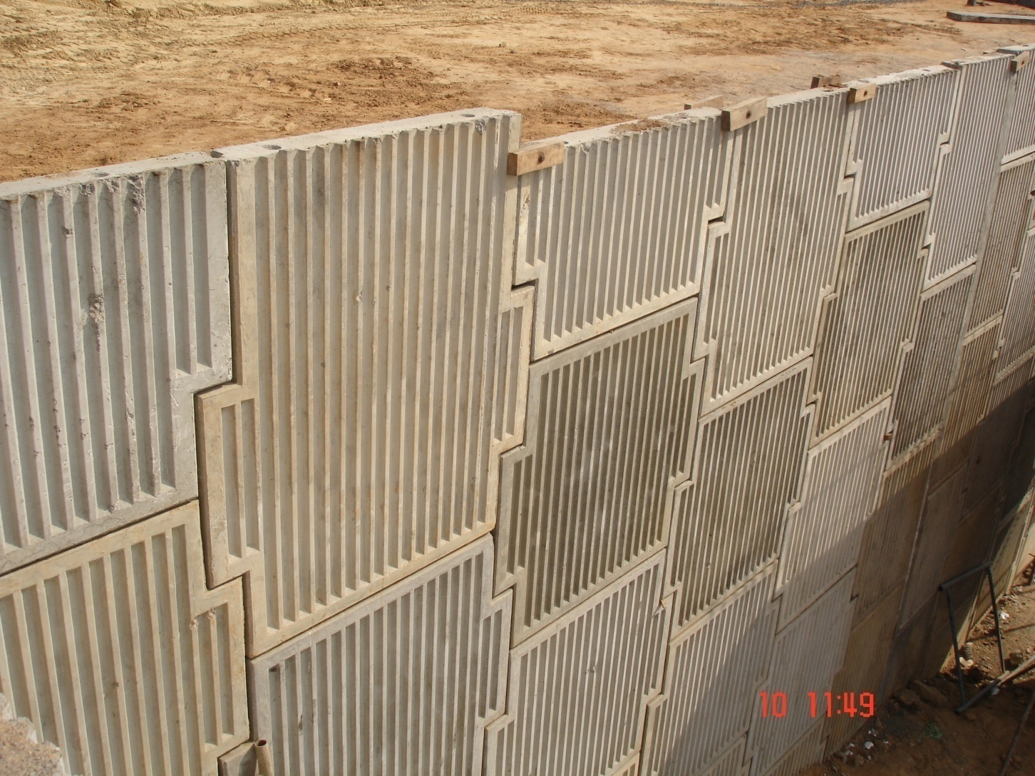

Slide 49
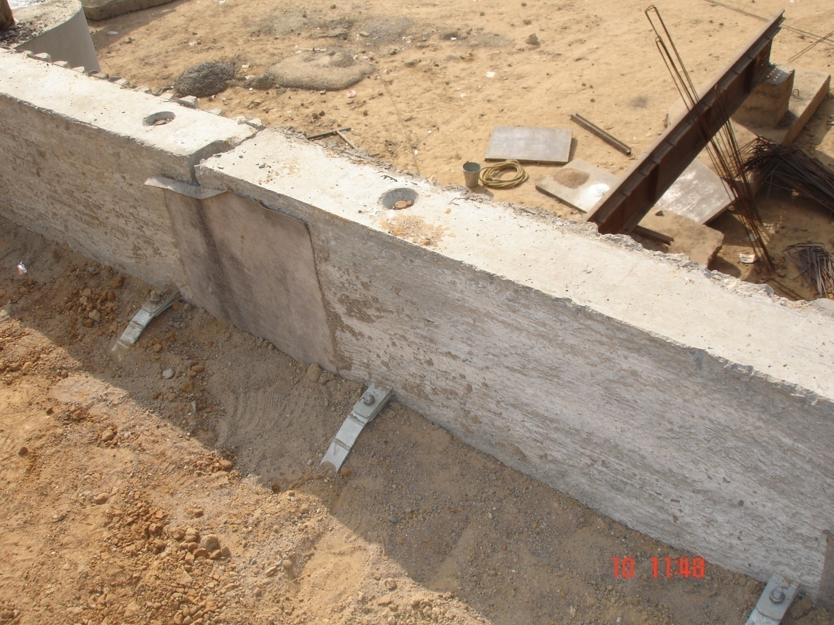

Slide 50
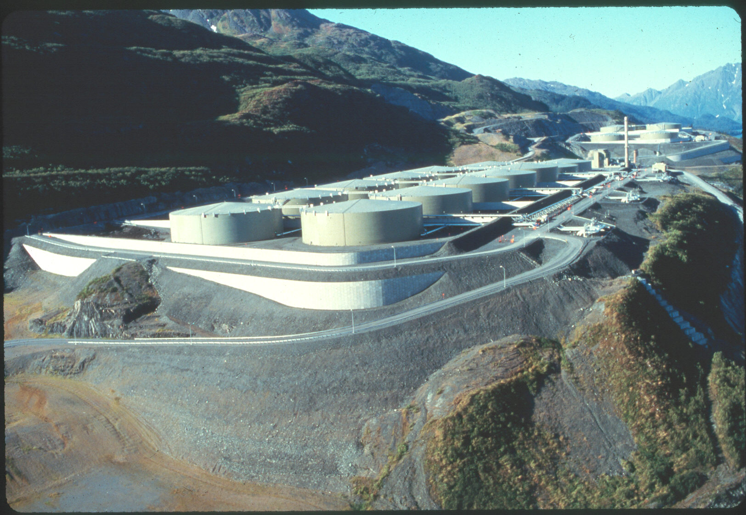
Reinforced Earth Wall, Valdez, Alaska

Slide 51
References:
IS:1892-1979: C.O.P. for site investigations for foundations.
IS:1904-1978: C.O.P. for structural safety of buildings-shallow foundations.
IS:6403-1981: C.O.P. for determination of bearing capacity of shallow foundations.
IS:8009 (Part 1)-1976: C.O.P. for calculations of settlements of foundations.
J. E. Bowles: Foundation Analysis and Design, McGraw-Hill Companies Inc, New York.
Alam Singh: Soil Engineering in Theory and Practice, Asia Publishing House, Mumbai
N. V. Nayak: Foundation Design Manual, Dhanpat Rai and Sons, New Delhi

Slide 52
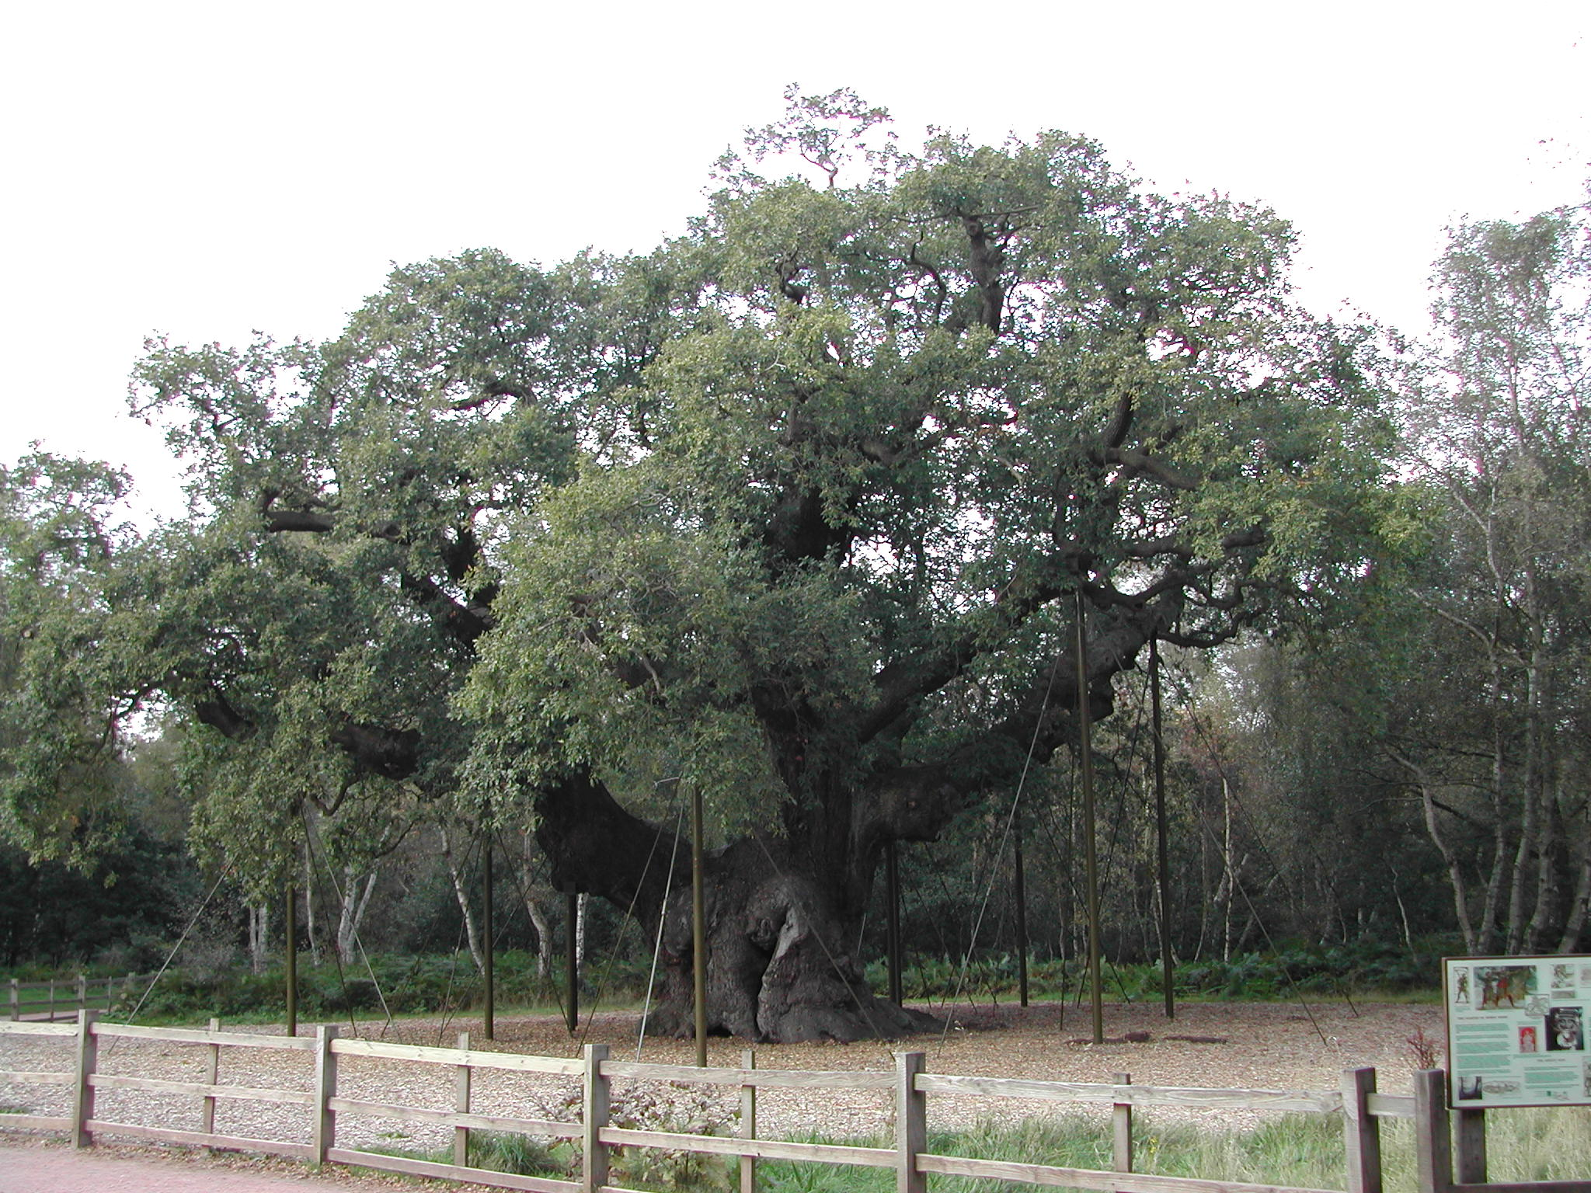
Thank You

